Slide 1
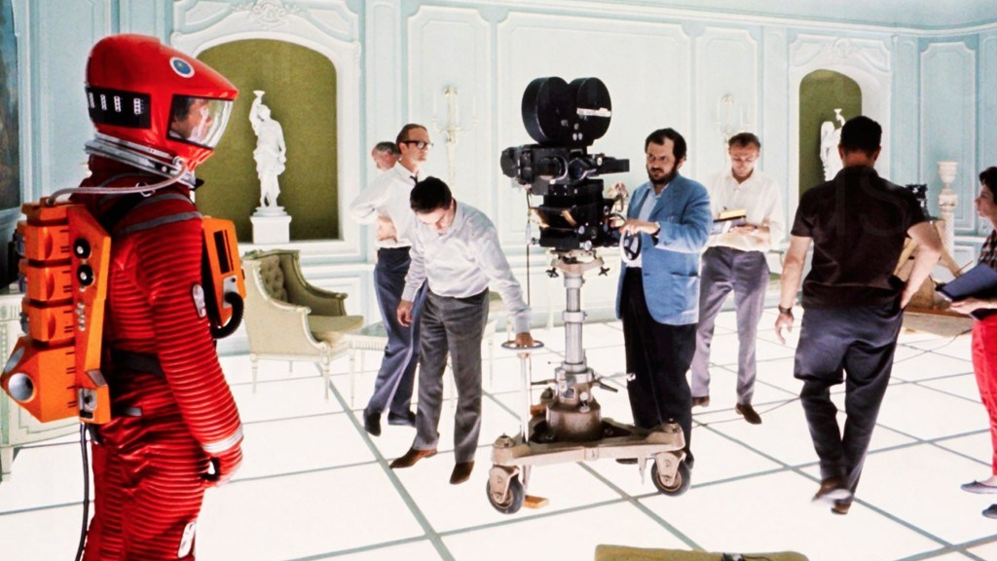
2001: A Space Odyssey (Stanley Kubrick-1968)

Slide 2

2020: A Digital Odyssey
Notes:
https://www.pinterest.ca/pin/231302130841121655/

Slide 3
Number Systems |
Number Systems | Logic Gates | Combinational Logic | Flip-Flops| Sequential Logic | Computer Systems

Slide 4
Number Systems |
(12)₁₀ → (1100)₂
Number Systems | Logic Gates | Combinational Logic | Flip-Flops| Sequential Logic | Computer Systems

Slide 5

Number Systems |
(12)₁₀ → (1100)₂
Number Systems | Logic Gates |
Number Systems | Logic Gates | Combinational Logic | Flip-Flops| Sequential Logic | Computer Systems

Slide 6
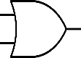
Number Systems |
(12)₁₀ → (1100)₂
Number Systems | Logic Gates |
Number Systems | Logic Gates | Combinational Logic |
Number Systems | Logic Gates | Combinational Logic | Flip-Flops| Sequential Logic | Computer Systems

Slide 7
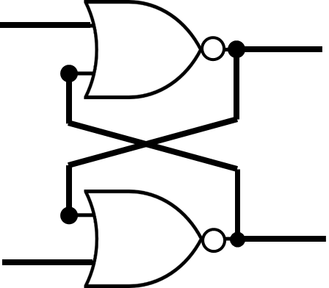
Number Systems |
(12)₁₀ → (1100)₂
Number Systems | Logic Gates |
Number Systems | Logic Gates | Combinational Logic |
Number Systems | Logic Gates | Combinational Logic | Flip-Flops |
Number Systems | Logic Gates | Combinational Logic | Flip-Flops| Sequential Logic | Computer Systems

Slide 8
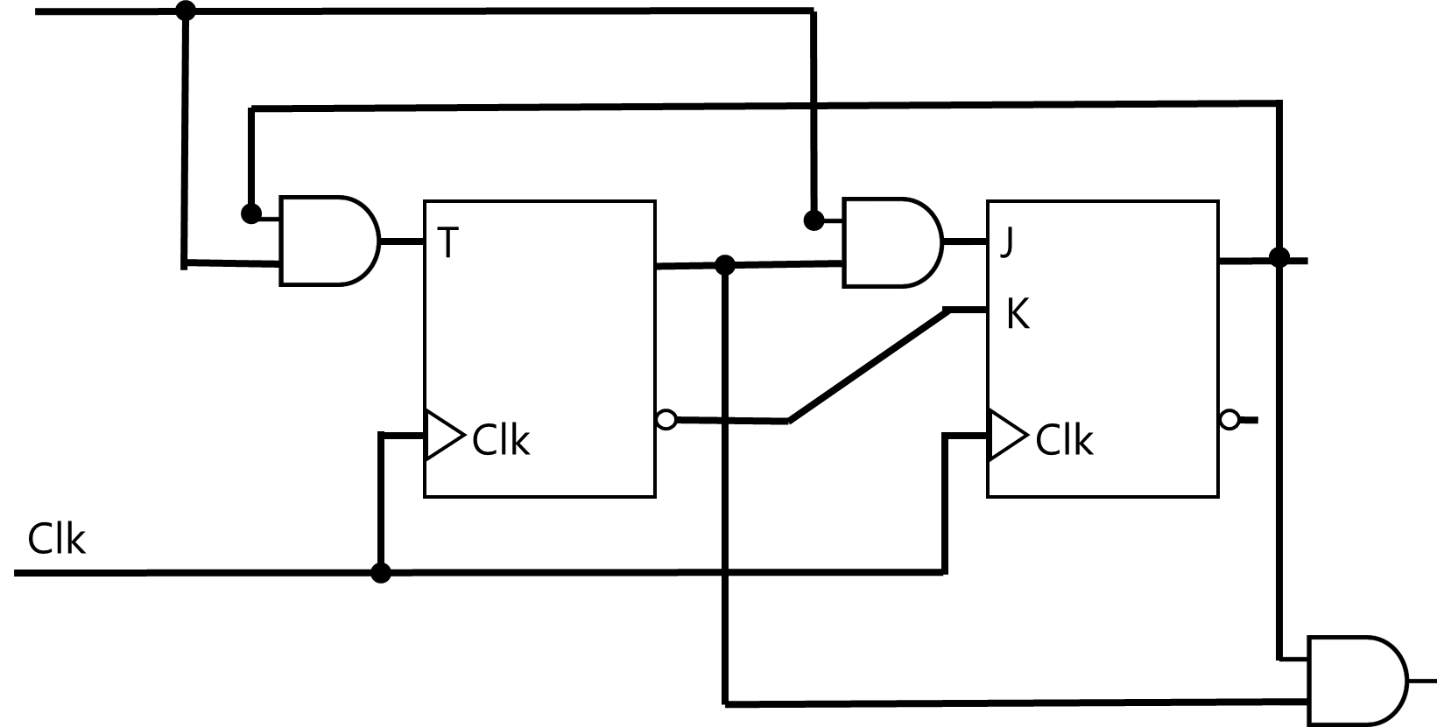
Number Systems |
(12)₁₀ → (1100)₂
Number Systems | Logic Gates |
Number Systems | Logic Gates | Combinational Logic |
Number Systems | Logic Gates | Combinational Logic | Flip-Flops |
Number Systems | Logic Gates | Combinational Logic | Flip-Flops | Sequential Logic |
Number Systems | Logic Gates | Combinational Logic | Flip-Flops| Sequential Logic | Computer Systems

Slide 9
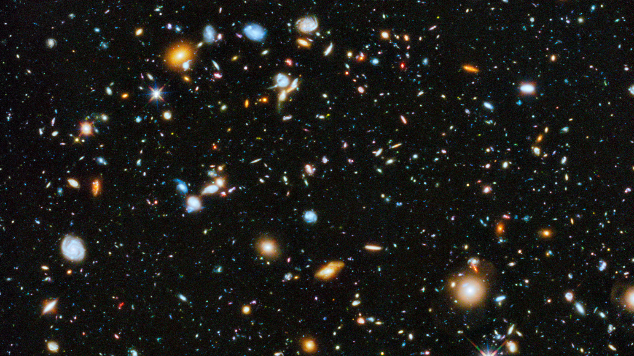
Computer science | & computers (gates)
astronomy | & telescopes (Stars)
“Computer science is no more about computers than astronomy is about telescopes” - Edsger Dijkstra
Notes:
Zoom into universe and stars
Zoom into cpu and gates
Mixing tools w/ Science but knowing the tools helps a lot with science

Slide 10
Distance
Height
Length
Problems

Slide 11
Computable
Theory of Automata
Theory of Computation
Theory of Computer Science
Problems

Slide 12
Problems
Programs

Slide 13
Problems
Algorithm
Data

Slide 14
Design a Computer System

Slide 15

John von Neumann
(/vɒn ˈnɔɪmən/)
1903 –1957
Mathematician, Physicist, Computer Scientist, Engineer
Polymath
He integrated pure and applied sciences. He made major contributions to many fields, including:
Mathematics
Physics
Economics (game theory)
Computing
Statistics

Slide 16
Problems
Data
Algorithm

Slide 17
Problems
Memory to Store
Data (Input, Output)
int a=1; int b=2; int c;
Data
Algorithm

Slide 18

Problems
Memory to Store
Data (Input, Output)
int a=1; int b=2; int c;
Data
Instructions (Code)
c = a + b;
Algorithm
Processor

Slide 19
Problems
Memory to Store
Data (Input, Output)
int a=1; int b=2; int c;
Data
Instructions (Code)
c = a + b;
Bus
Algorithm
Processor

Slide 20
Problems
Computer
Memory to Store
Data (Input, Output)
int a=1; int b=2; int c;
Data
Instructions (Code)
c = a + b;
Bus
Algorithm
Processor

Slide 21
von Neumann Architecture
Principles
Data and instructions are both stored in the main memory
The content of the memory is addressable by location (regardless of what is stored in that location)
Instructions are executed sequentially unless the order is explicitly modified

Slide 22
Computer
System
Computer
Memory to Store
Data (Input, Output)
int a=1; int b=2; int c;
Instructions (Code)
c = a + b;
Input/Output
Devices
scanf("%d", &a);
scanf("%d", &b);
printf("%d", c);
Bus
Bus
Bus
Permanent Storage
fprintf() fscanf() fread() fwrite() fseek()
Processor

Slide 23
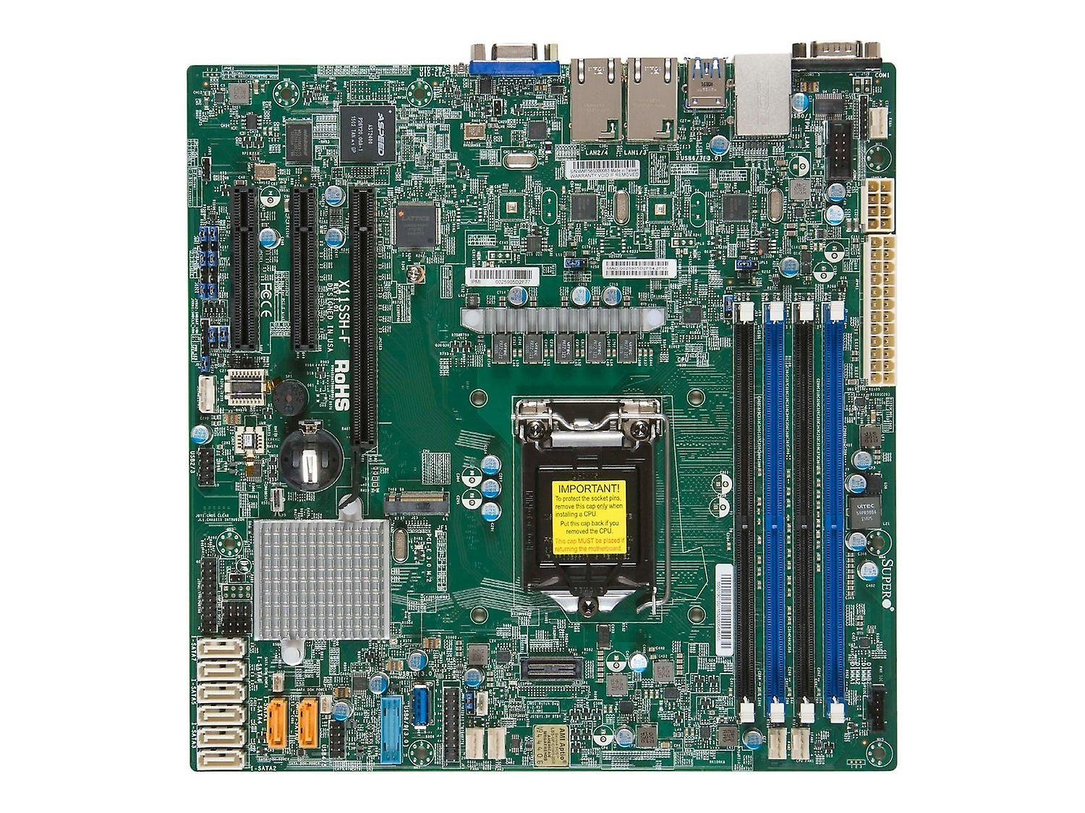

Slide 24
I/O
I/O
Power
Processor
Memory to Store
I/O

Slide 25
Memory to Store

Slide 26
Design Memory
To Store Data + Code

Slide 27
Design Memory
Data → Numbers

Slide 28
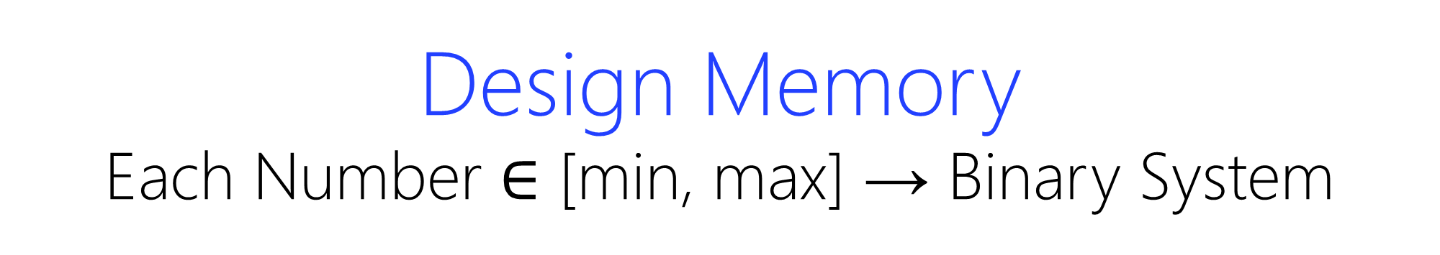
Design Memory
Each Number $∈$ [min, max] → Binary System

Slide 29

Design Memory
Each Number $∈$ [0, 2^{n}) → n Flip-Flops

Slide 30
D
D
D
D
Clk
n=4 → Each Number $∈$ [0, 2⁴=16) → 4 Flip-Flops

Slide 31
(12)₁₀ = (1100)₂
D
D
D
D
1
1
0
0
Clk
n=4 → Each Number $∈$ [0, 2⁴=16) → 4 Flip-Flops

Slide 32
(N)₁₀ = (wzyx)₂
D
D
D
D
W
Z
Y
X
Clk
1 × Number → 1 × n FFs → 1 × n-bit Register
Register → an vector of flip-flops

Slide 33
(N)₁₀ = (wzyx)₂
D
D
D
D
W
Z
Y
X
Clk
D
D
D
D
W
Z
Y
X
2 × Numbers → 2 × n FFs → 2 × n-bit Registers

Slide 34
(N)₁₀ = (wzyx)₂
D
D
D
D
W
Z
Y
X
Clk
D
D
D
D
W
Z
Y
X
D
D
D
D
W
Z
Y
X
3 × Numbers → 3 × n FFs → 3 × n-bit Registers

Slide 35
4-bit Bus
D
D
D
D
W
Z
Y
X
Clk
D
D
D
D
W
Z
Y
X
D
D
D
D
W
Z
Y
X
D
D
D
D
W
Z
Y
X
4 × Numbers → 4 × n FFs → 4 × n-bit Registers

Slide 36
4-bit Bus
D
D
D
D
W
Z
Y
X
Clk
D
D
D
D
W
Z
Y
X
What is the problem?
D
D
D
D
W
Z
Y
X
D
D
D
D
W
Z
Y
X
4 × Numbers → 4 × n FFs → 4 × n-bit Registers

Slide 37
4-bit Bus
D
D
D
D
W
Z
Y
X
Clk
D
D
D
D
W
Z
Y
X
Problem!
1 number goes to all registers.
D
D
D
D
W
Z
Y
X
D
D
D
D
W
Z
Y
X
4 × Numbers → 4 × n FFs → 4 × n-bit Registers

Slide 38
Which Register?

Slide 39
Select Register by Name?

Slide 40
4-bit Bus
 |  |  |  | A
 |  |  |  | B
 |  |  |  | C
 |  |  |  | D
D
D
D
D
Clk
D
D
D
D
D
D
D
D
D
D
D
D
4 × Numbers → 4 × n FFs → 4 × n-bit Registers

Slide 41
Select Register by Address?

Slide 42
4-bit Bus
 |  |  |  | 00
 |  |  |  | 01
 |  |  |  | 10
 |  |  |  | 11
D
D
D
D
Clk
D
D
D
D
D
D
D
D
D
D
D
D

Slide 43
4-bit Data Bus
2-bit Address Bus
2× 2²
Dec.
D
D
D
D
R₀
Clk
D
D
D
D
R₁
D
D
D
D
R₂
D
D
D
D
R₃

Slide 44
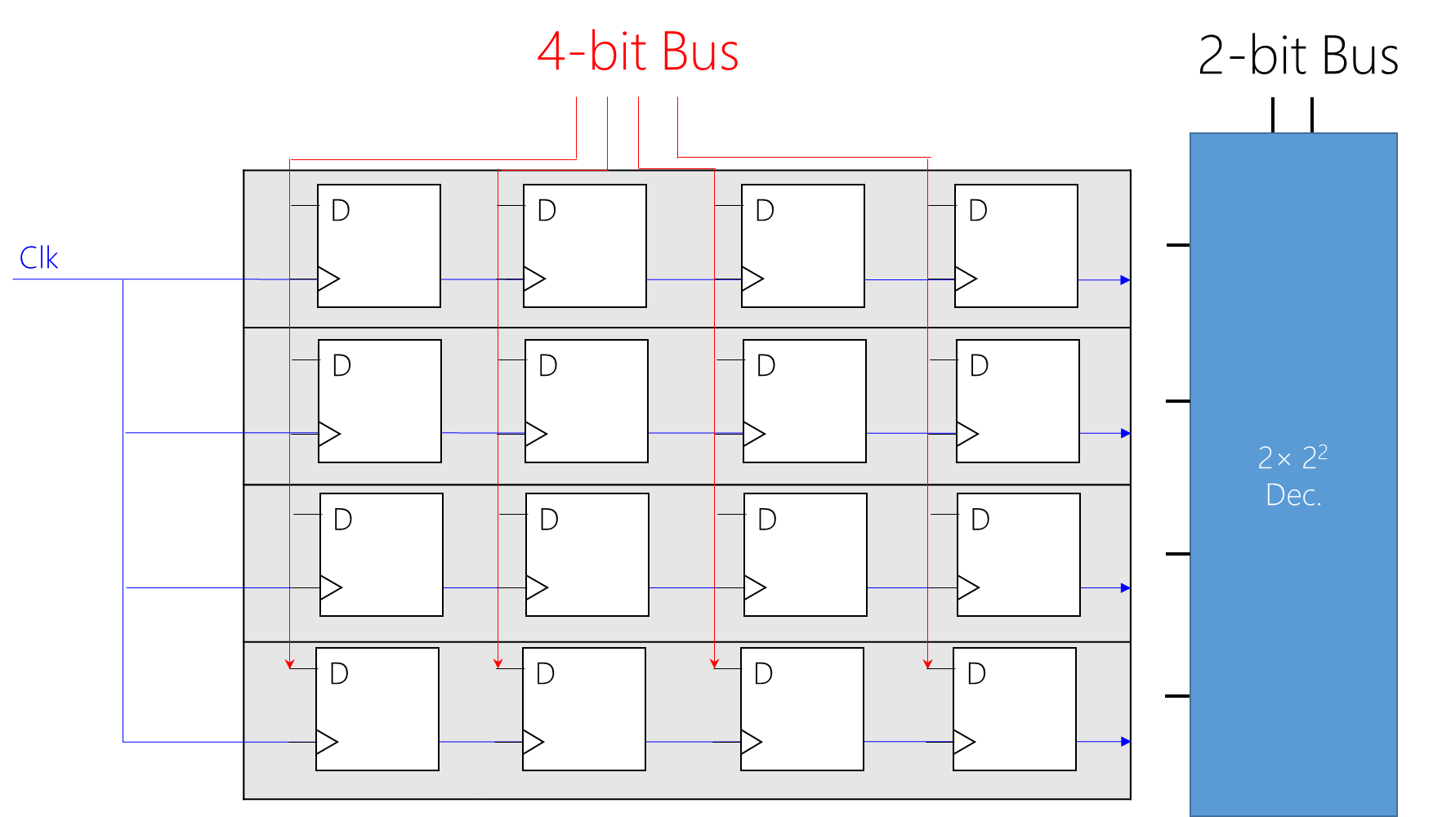
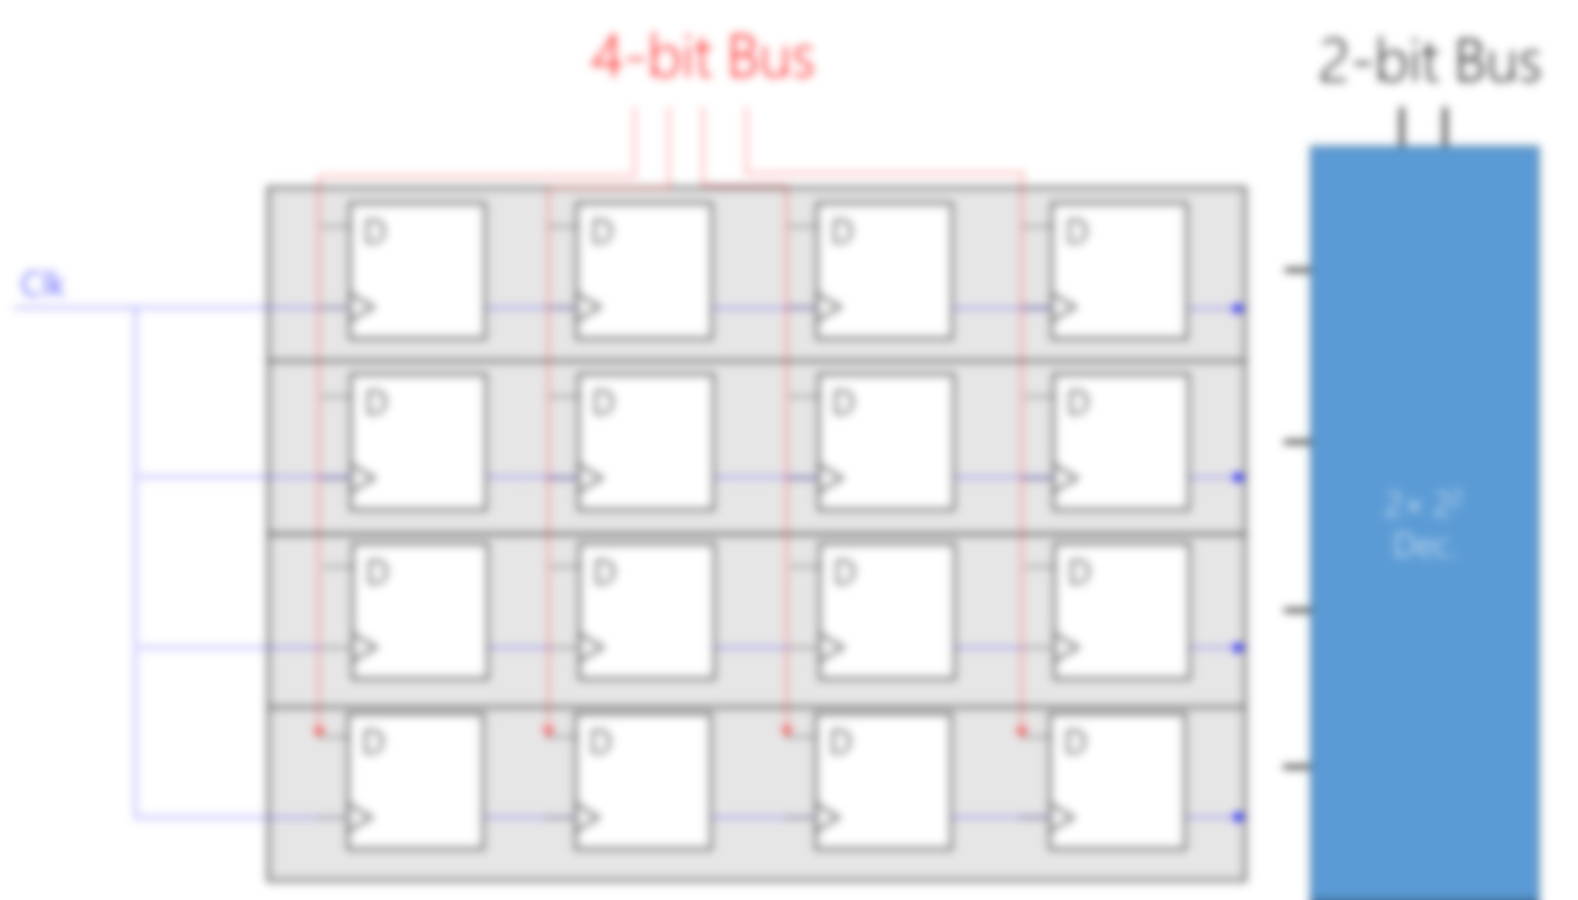

Slide 45
Input: I₀
Select: R₀
D
if R₀ (selected) then Write (Load) (I₀ → D-FF)
else Store

Slide 46
Input: I₀
Select: R₀
D
if R₀ (selected) then Write (Load) (I₀ → D-FF)
else Store but D-FF does not have store action!

Slide 47
Input: I₀
Select: R₀
D
Clk
D

Slide 48
Input: I₀
Select: R₀
D
Clk
D
Never ever touch clock! Why?

Slide 49
Input: I₀
Current Value Q
Select: R₀
D
if R₀ (selected) then Write(Load) (I₀ → D-FF)
else Store

Slide 50
Input: I₀
Current Value Q
Select: R₀
2×1
MUX
D
S₀
if R₀ (selected) then Write(Load) (I₀ → D-FF)
else Store

Slide 51
4-bit Data Bus
2-bit Address Bus
2× 2²
Dec.
D
D
D
D
R₀
Clk
D
D
D
D
R₁
D
D
D
D
R₂
D
D
D
D
R₃

Slide 52
0101
1 0
2× 2²
Dec.
D
D
D
D
0
R₀
Clk
D
D
D
D
0
R₁
D
D
D
D
1
0
1
0
1
R₂
0
D
D
D
D
R₃

Slide 53
0101
1 0
2× 2²
Dec.
D
D
D
D
0
Q_{t}
Q_{t}
Q_{t}
Q_{t}
R₀
Clk
D
D
D
D
0
R₁
D
D
D
D
1
0
1
0
1
R₂
0
D
D
D
D
R₃

Slide 54
n-bit Data Bus
? × ?
Memory
Module
m-bit Address Bus

Slide 55
n-bit Data Bus
2^{m} × n-bit
Memory
Module
m-bit Address Bus

Slide 56
n-bit Data Bus
Size of bus is fixed!
2^{m} × n-bit
Memory
Module
m-bit Address Bus

Slide 57
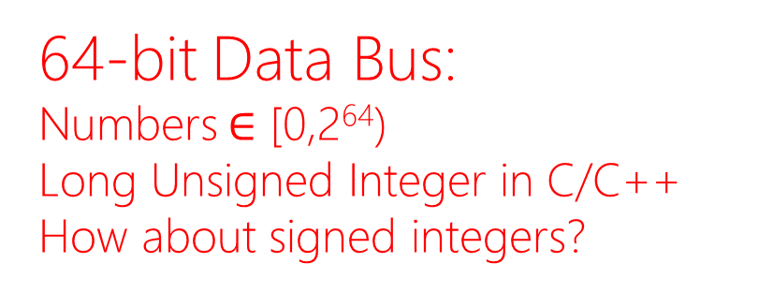
64-bit Data Bus:
Numbers $∈$ [0,2⁶⁴)
Long Unsigned Integer in C/C++
How about signed integers?
64-bit Address Bus:
2⁶⁴ Memory Locations

Slide 58
64-bit Data Bus
2⁶⁴ × 64-bit
Memory
Module
Buying 2⁶⁴ !
You must be rich.
You don’t need it
64-bit Address Bus
2⁶⁴=2¹⁰×2¹⁰×2¹⁰×2¹⁰×2¹⁰×2¹⁰×2⁴ = 16 Exa Memory Locations
Kilo→Mega→Giga→Peta→Exa

Slide 59
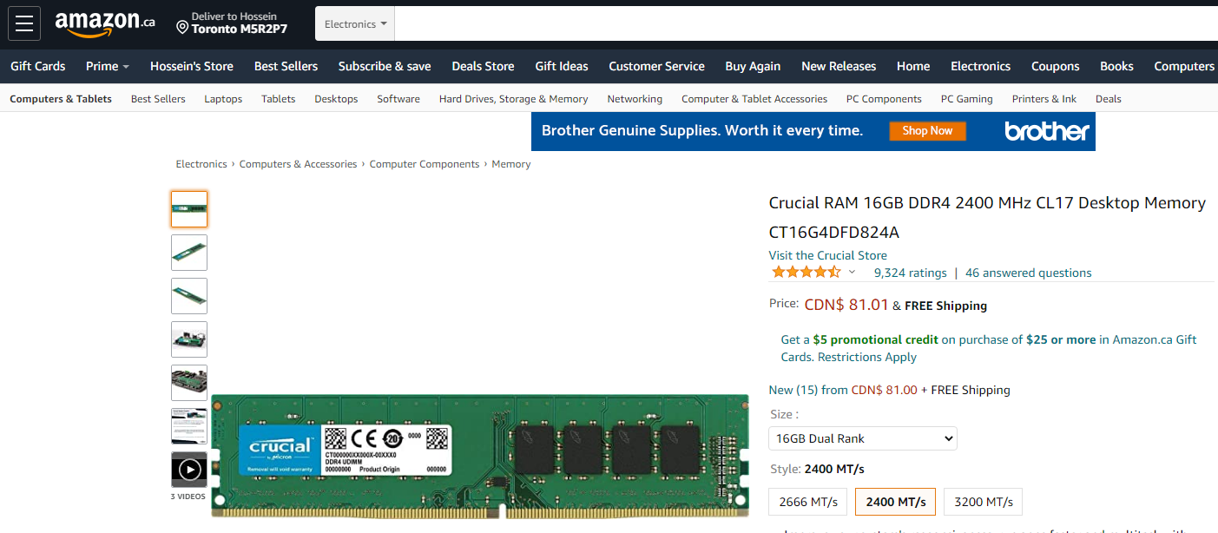
16 G = 16×2¹⁰ (M) = 16×2¹⁰×2¹⁰ (K) = 16×2¹⁰×2¹⁰×2¹⁰ Memory Locations

Slide 60
16 G = 16×2¹⁰ (M) = 16×2¹⁰×2¹⁰ (K) = 16×2¹⁰×2¹⁰×2¹⁰ Memory Locations
How many FFs?

Slide 61
16 G = 16×2¹⁰ (M) = 16×2¹⁰×2¹⁰ (K) = 16×2¹⁰×2¹⁰×2¹⁰ Memory Locations
How many FFs?
(2⁴=16)×2¹⁰×2¹⁰×2¹⁰×(2⁶=64-bit Data Bus) = 2⁴⁰

Slide 62
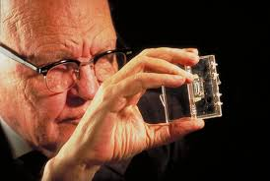
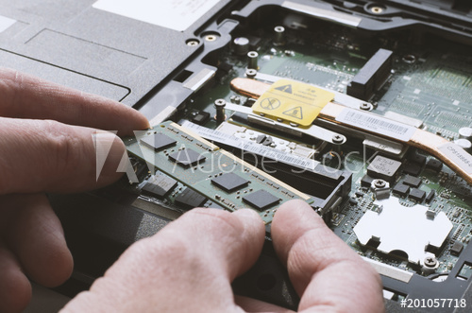
16 G = 16×2¹⁰ (M) = 16×2¹⁰×2¹⁰ (K) = 16×2¹⁰×2¹⁰×2¹⁰ Memory Locations
How many FFs?
(2⁴=16)×2¹⁰×2¹⁰×2¹⁰×(2⁶=64-bit Data Bus) = 2⁴⁰
1958–1959
2012-2013

Slide 63
2020: A Digital Odyssey
Notes:
https://www.pinterest.ca/pin/231302130841121655/

Slide 64
n-bit Data Bus (Write)
2^{m} × n-bit
Memory
Module
m-bit Address Bus
n-bit Data Bus (Read)

Slide 65
1 0
2× 2²
Dec.
D
D
D
D
R₀
Clk
D
D
D
D
R₁
D
D
D
D
R₂
D
D
D
D
R₃

Slide 66
0 1
2× 2²
Dec.
D
D
D
D
R₀
Clk
D
D
D
D
R₁
D
D
D
D
R₂
D
D
D
D
R₃

Slide 67
2× 2²
Dec.
D
D
D
D
R₀
Clk
D
D
D
D
R₁
D
D
D
D
0
1
0
1
R₂
D
D
D
D
R₃
MUX
4×1
MUX
4×1
MUX
4×1
MUX
4×1

Slide 68
1 0
2× 2²
Dec.
D
D
D
D
R₀
Clk
D
D
D
D
R₁
D
D
D
D
0
1
0
1
R₂
D
D
D
D
R₃
MUX
4×1
MUX
4×1
MUX
4×1
MUX
4×1

Slide 69
1 0
2× 2²
Dec.
D
D
D
D
R₀
Clk
D
D
D
D
R₁
At the positive edge, both write and read!
D
D
D
D
0
1
0
1
R₂
D
D
D
D
R₃
MUX
4×1
MUX
4×1
MUX
4×1
MUX
4×1

Slide 70
Alternative Design

Slide 71
Input (I)
Current Value (Q_{t})
Select (S)
2×1
MUX
D
Q_{t}
S₀

Slide 72
Input (I)
Current Value (Q_{t})
Select (S)
2×1
MUX
D
Q_{t}
S₀
Control (C)
0: Read(R)
1: Write(W)

Slide 73
Input (I)
Current Value (Q_{t})
Store
C does not matter!
Select (S)=0
2×1
MUX
D
Q_{t}
S₀
Control (C)
0: Read(R)
1: Write(W)
Output=0
C does not matter!
D

Slide 74
Input (I)
Current Value (Q_{t})
Select (S)=1
2×1
MUX
D
Q_{t}
S₀
Control (C)
0: Read(R)
1: Write(W)
D

Slide 75
Input (I)
Current Value (Q_{t})
Select (S)=1
2×1
MUX
D
Q_{t}
D
S₀
Control (C)
0: Read(R)
D
Output=Q_{t}

Slide 76
Input (I)
Current Value (Q_{t})
Select (S)=1
2×1
MUX
D
Q_{t}
D
S₀
Control (C)
1: Write(W)
D
Output=0

Slide 77
Input (I)
Current Value (Q_{t})
Select (S)
2×1
MUX
D
Q_{t}
D
S₀
Control (C)
D
Output

Slide 78
Input (I)
Memory Cell
Current Value (Q_{t})
Select (S)
2×1
MUX
D
Q_{t}
D
S₀
Control (C)
D
Output

Slide 79
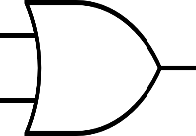
Input (I)
Select (S)
2× 2²
Dec.
Control (C)
R₀
(R/W’)
R₁
R₂
Clk is not shown but exists!
R₃
Output

Slide 80
Input (I)
1 0
Control (C)=0
(Read)
2× 2²
Dec.
R₀
R₁
Q_{t}
Q_{t}
Q_{t}
Q_{t}
R₂
Clk is not shown but exists!
R₃
0 00
0 00
0 00
0 00
Output
Q_{t}
Q_{t}
Q_{t}
Q_{t}

Slide 81
Input (I)
1 0
I₀
I₁
I₂
I₃
Control (C)=1
(Write)
2× 2²
Dec.
R₀
R₁
0
0
0
0
I₀
I₁
I₂
I₃
R₂
Clk is not shown but exists!
R₃
0 00
0 00
0 00
0 00
Output
0
0
0
0

Slide 82
n-bit Data Bus (Write)
2^{m} × n-bit
Memory
Module
m-bit Address Bus
k-bit Control Bus
n-bit Data Bus (Read)

Slide 83
Input and Output
Same Data Bus vs. Another Data Bus

Slide 84
n-bit Data Bus (Write/ Read)
2^{m} × n-bit
Memory
Module
m-bit Address Bus
k-bit Control Bus

Slide 85
Access
Random vs. Sequential

Slide 86
Access
Random vs. Sequential
Random: regardless of location, always fixed Δt.
Sequential: closer location sooner, farther location longer!

Slide 87
Access
Random vs. Sequential
How long does it take to select a memory location (register)?
E.g., if address bus loads 00,
how long is the wait to read this memory location?
how long is the wait to write this memory location?

Slide 88
Input (I)
0 0
2× 2²
Dec.
Control (C)
R₀
(R/W’)
R₁
R₂
Clk is not shown but exists!
R₃
Output

Slide 89
Access
Random vs. Sequential
How long does it take to select a memory location (register)?
E.g., if address bus loads 11,
how long is the wait to read this memory location?
how long is the wait to write this memory location?

Slide 90
Input (I)
1 1
2× 2²
Dec.
Control (C)
R₀
(R/W’)
R₁
R₂
Clk is not shown but exists!
R₃
Output

Slide 91
Random Access Memory
(RAM)
Regardless of memory location, always fixed Δt.

Slide 92
I/O
I/O
Power
Processor
Memory to Store
I/O

Slide 93
Random Access Read-only Memory
(ROM)
They don’t have control bus for writing!
To store static data.
Still can write (update) but via physical procedures.

Slide 94
2^{m} × n-bit
Memory
Module
m-bit Address Bus
n-bit Data Bus (Read)

Slide 95
I/O
I/O
Power
Processor
Memory to Store
I/O

